Slide 1

Chapter 10 Lists

Slide 2
Opening Problem
Read one hundred numbers, compute their average, and find out how many numbers are above the average.

Slide 3

Solution
DataAnalysis

Slide 4
Objectives
To describe why lists are useful in programming (§10.1).
To create lists (§10.2.1).
To invoke list’s append, insert, extend, remove, pop, index, count, sort, reverse methods (§10.2.2).
To use the len, min/max, sum, and random.shuffle functions for a list (§10.2.3).
To access list elements using indexed variables (§10.2.4).
To obtain a sublist using the slicing operator [start:end] (§10.2.5).
To use +, *, and in/not in operators on lists (§10.2.6).
To traverse elements in a list using a for-each loop (§10.2.7).
To create lists using list comprehension (§10.2.8).
To compare lists using comparison operators (§10.2.9).
To split a string to a list using the str’s split method (§10.2.10).
To use lists in the application development (§§10.3–10.5).
To copy contents from one list to another (§10.6).
To develop and invoke functions with list arguments and return value (§10.7–10.9).
To search elements using the linear (§10.10.1) or binary (§10.10.2) search algorithm.
To sort a list using the selection sort (§10.11.1)
To sort a list using the insertion sort (§10.11.2).
To develop the bouncing ball animation using a list (§10.12).

Slide 5
Creating Lists
Creating list using the list class
list1 = list() # Create an empty list
list2 = list([2, 3, 4]) # Create a list with elements 2, 3, 4
list3 = list(["red", "green", "blue"]) # Create a list with strings
list4 = list(range(3, 6)) # Create a list with elements 3, 4, 5
list5 = list("abcd") # Create a list with characters a, b, c
For convenience, you may create a list using the following syntax:
list1 = [] # Same as list()
list2 = [2, 3, 4] # Same as list([2, 3, 4])
list3 = ["red", "green"] # Same as list(["red", "green"])

Slide 6
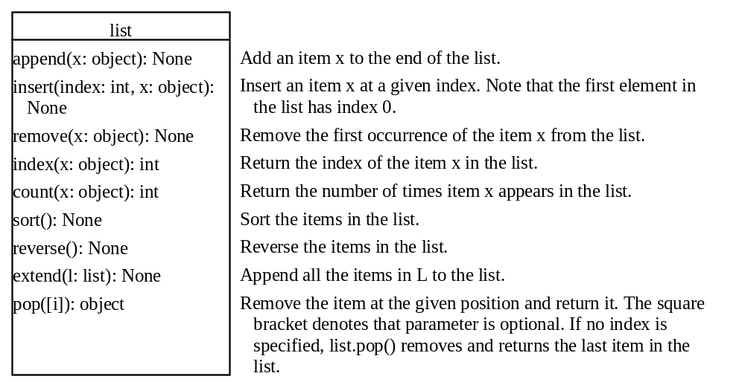
list Methods

Slide 7
Functions for lists
>>> list1 = [2, 3, 4, 1, 32]
>>> len(list1)
5
>>> max(list1)
32
>>> min(list1)
1
>>> sum(list1)
42
>>> import random
>>> random.shuffle(list1) # Shuffle the items in the list
>>> list1
[4, 1, 2, 32, 3]

Slide 8
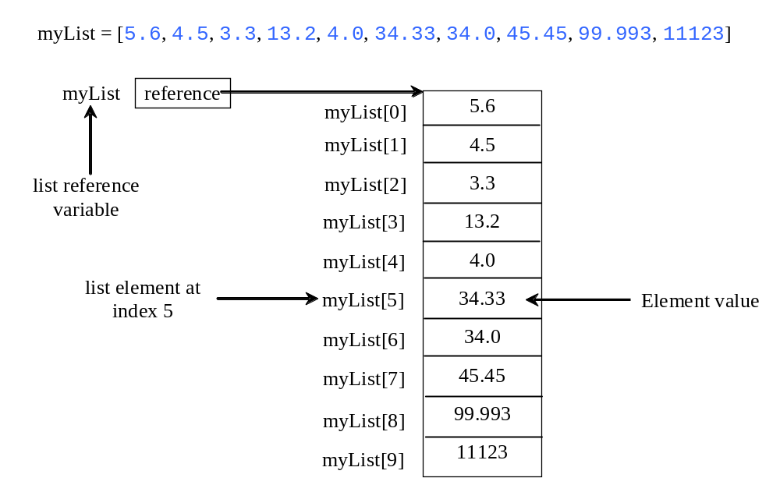
Indexer Operator []

Slide 9
The +, *, [ : ], and in Operators
>>> list1 = [2, 3]
>>> list2 = [1, 9]
>>> list3 = list1 + list2
>>> list3
[2, 3, 1, 9]
>>> list3 = 2 * list1
>>> list3
[2, 3, 2, 3, 2, 3]
>>> list4 = list3[2 : 4]
>>> list4
[2, 3]

Slide 10
The +, *, [ : ], and in Operators
>>> list1 = [2, 3, 5, 2, 33, 21]
>>> list1[-1]
21
>>> list1[-3]
2
>>> list1 = [2, 3, 5, 2, 33, 21]
>>> 2 in list1
True
>>> list1 = [2, 3, 5, 2, 33, 21]
>>> 2.5 in list1
False

Slide 11
off-by-one Error
i = 0
while i <= len(lst):
print(lst[i])
i += 1

Slide 12
List Comprehension
List comprehensions provide a concise way to create items from sequence. A list comprehension consists of brackets containing an expression followed by a for clause, then zero or more for or if clauses. The result will be a list resulting from evaluating the expression. Here are some examples:
>>> list1 = [x for x range(0, 5)] # Returns a list of 0, 1, 2, 4
>>> list1
[0, 1, 2, 3, 4]
>>> list2 = [0.5 * x for x in list1]
>>> list2
[0.0, 0.5, 1.0, 1.5, 2.0]
>>> list3 = [x for x in list2 if x < 1.5]
>>> list3
[0.0, 0.5, 1.0]

Slide 13
Comparing Lists
>>>list1 = ["green", "red", "blue"]
>>>list2 = ["red", "blue", "green"]
>>>list2 == list1
False
>>>list2 != list1
True
>>>list2 >= list1
False
>>>list2 > list1
False
>>>list2 < list1
True
>>>list2 <= list1
True

Slide 14
Splitting a String to a List
items = "Welcome to the US".split()
print(items)
['Welcome', 'to', 'the', 'US']
items = "34#13#78#45".split("#")
print(items)
['34', '13', '78', '45']

Slide 15
Problem: Lotto Numbers
Suppose you play the Pick-10 lotto. Each ticket has 10 unique numbers ranging from 1 to 99. You buy a lot of tickets. You like to have your tickets to cover all numbers from 1 to 99. Write a program that reads the ticket numbers from a file and checks whether all numbers are covered. Assume the last number in the file is 0.
Lotto Numbers Sample Data
LottoNumbers
Run

Slide 16
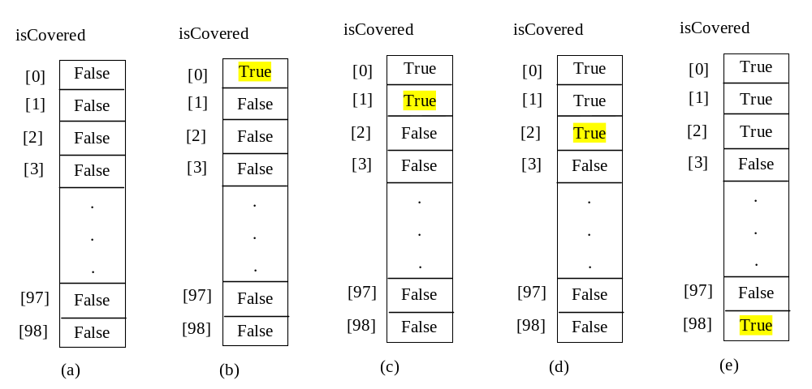
Problem: Lotto Numbers

Slide 17
Problem: Deck of Cards
The problem is to write a program that picks four cards randomly from a deck of 52 cards. All the cards can be represented using a list named deck, filled with initial values 0 to 51, as follows:
  deck = [x for x in range(0, 52)]
DeckOfCards
Run

Slide 18
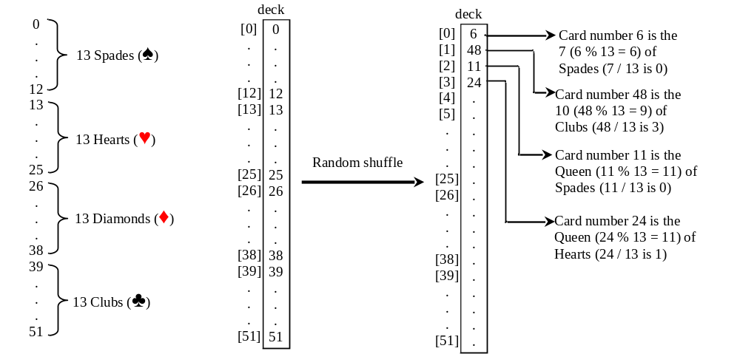
Problem: Deck of Cards, cont.

Slide 19
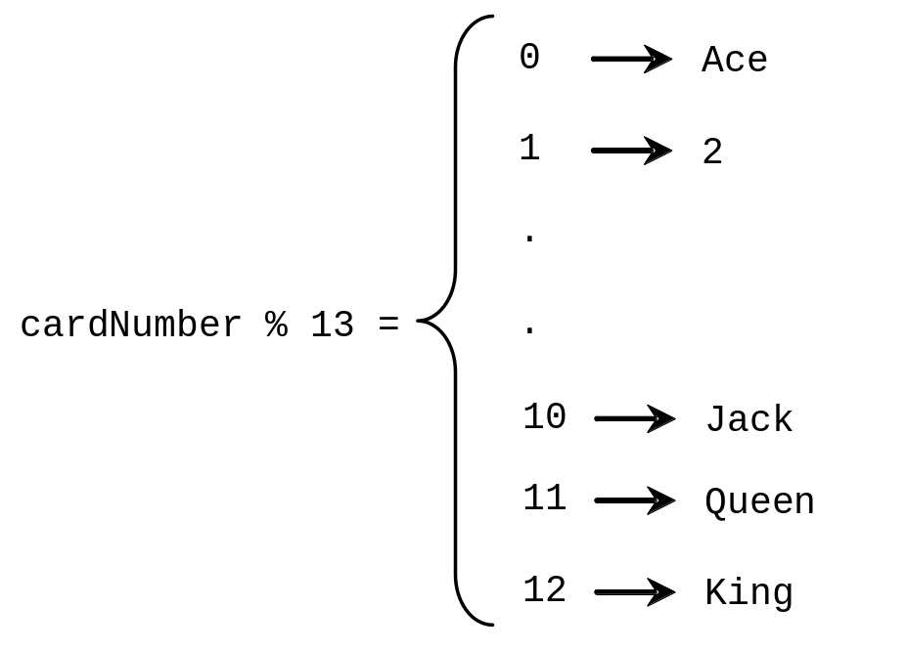
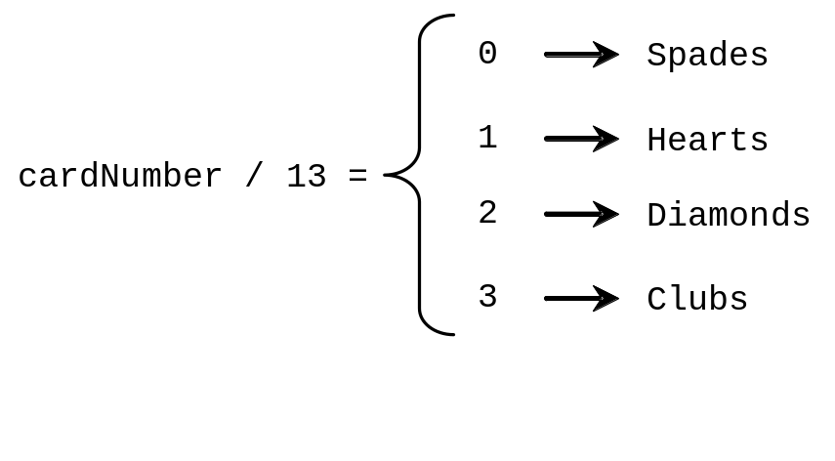
Problem: Deck of Cards, cont.
DeckOfCards
Run

Slide 20
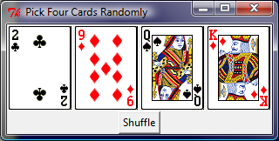
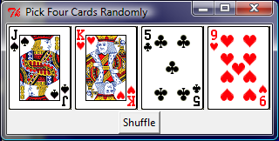
GUI: Deck of Cards
DeckOfCardsGUI
DeckOfCards

Slide 21
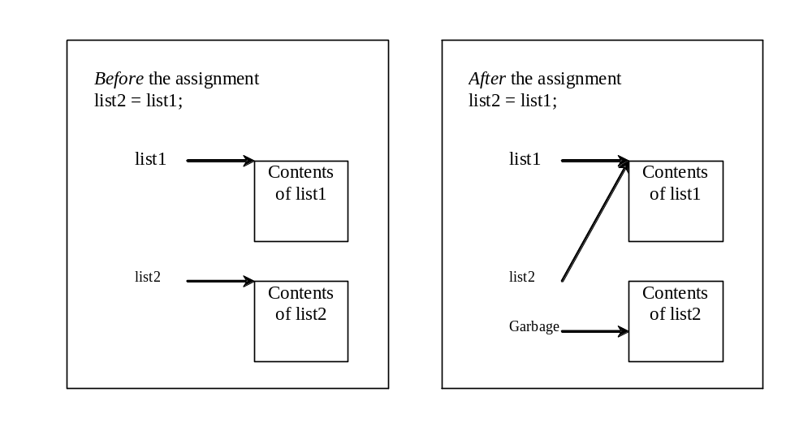
Copying Lists
Often, in a program, you need to duplicate a list or a part of a list. In such cases you could attempt to use the assignment statement (=), as follows:
list2 = list1;

Slide 22
Passing Lists to Functios
def printList(lst):
for element in lst:
print(element)
Invoke the function
lst = [3, 1, 2, 6, 4, 2]
printList(lst)
Invoke the function
printList([3, 1, 2, 6, 4, 2])
Anonymous list

Slide 23
Pass By Value
Python uses pass-by-value to pass arguments to a function. There are important differences between passing the values of variables of numbers and strings and passing lists.
Immutable objects
Changeable objects

Slide 24
Pass By Value (Immutable objects)
For an argument of a number or a string, the original value of the number and string outside the function is not changed, because numbers and strings are immutable in Python.

Slide 25
Pass By Value (changeable objects)
For an argument of a list, the value of the argument is a reference to a list; this reference value is passed to the function. Semantically, it can be best described as pass-by-sharing, i.e., the list in the function is the same as the list being passed. So if you change the list in the function, you will see the change outside the function.

Slide 26
Simple Example
def main():
x = 1 # x represents an int value
y = [1, 2, 3] # y represents a list
m(x, y) # Invoke f with arguments x and y
print("x is " + str(x))
print("y[0] is " + str(y[0]))
def m(number, numbers):
number = 1001 # Assign a new value to number
numbers[0] = 5555 # Assign a new value to numbers[0]
main()

Slide 27
Subtle Issues Regarding Default Arguments
def add(x, lst = []):
if not(x in lst):
lst.append(x)
return lst
list1 = add(1)
print(list1)
list2 = add(2)
print(list2)
list3 = add(3, [11, 12, 13, 14])
print(list3)
list4 = add(4)
print(list4)
default value is created only once.
Output
[1]
[1, 2]
[11, 12, 13, 14]
[1, 2, 4]

Slide 28
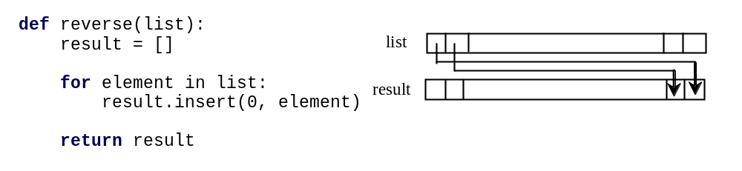
Returning a List from a Function
list1 = [1, 2, 3, 4, 5, 6]
list2 = reverse(list1)
Note that list already has the reverse method
list.reverse()

Slide 29
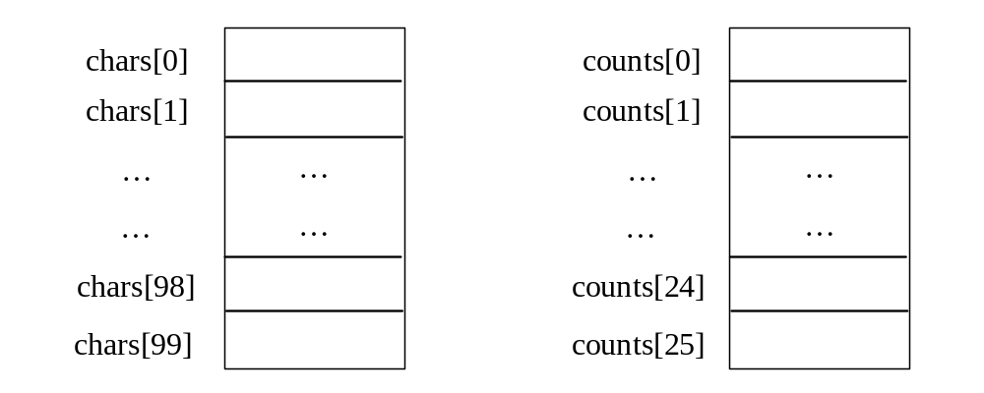
Problem: Counting Occurrence of Each Letter
Generate 100 lowercase letters randomly and assign to a list of characters.
Count the occurrence of each letter in the list.
CountLettersInList
Run

Slide 30
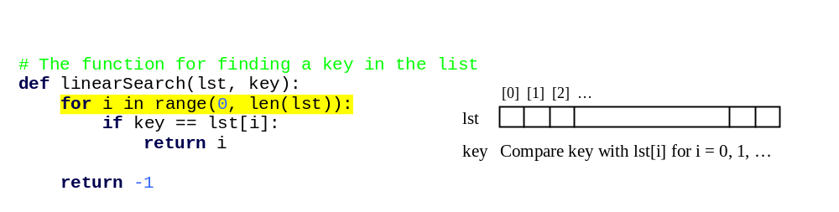
Searching Lists
Searching is the process of looking for a specific element in a list; for example, discovering whether a certain score is included in a list of scores. Searching is a common task in computer programming. There are many algorithms and data structures devoted to searching. In this section, two commonly used approaches are discussed, linear search and binary search.

Slide 31
Linear Search
The linear search approach compares the key element, key, sequentially with each element in list. The method continues to do so until the key matches an element in the list or the list is exhausted without a match being found. If a match is made, the linear search returns the index of the element in the list that matches the key. If no match is found, the search returns -1.

Slide 32
Linear Search Animation
animation
Key
List
3
6 | 4 | 1 | 9 | 7 | 3 | 2 | 8
3
6 | 4 | 1 | 9 | 7 | 3 | 2 | 8
3
6 | 4 | 1 | 9 | 7 | 3 | 2 | 8
3
6 | 4 | 1 | 9 | 7 | 3 | 2 | 8
3
6 | 4 | 1 | 9 | 7 | 3 | 2 | 8
3
6 | 4 | 1 | 9 | 7 | 3 | 2 | 8

Slide 33
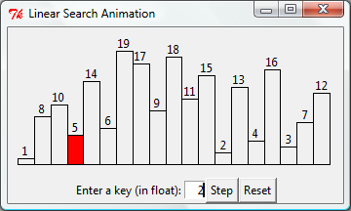
Linear Search Animation
animation
http://www.cs.armstrong.edu/liang/animation/LinearSearchAnimation.html

Slide 34
Binary Search
For binary search to work, the elements in the list must already be ordered. Without loss of generality, assume that the list is in ascending order.
  e.g., 2 4 7 10 11 45 50 59 60 66 69 70 79
The binary search first compares the key with the element in the middle of the list.

Slide 35
Binary Search, cont.
Consider the following three cases:
If the key is less than the middle element, you only need to search the key in the first half of the list.
If the key is equal to the middle element, the search ends with a match.
If the key is greater than the middle element, you only need to search the key in the second half of the list.

Slide 36
Binary Search
animation
Key
List
8
1 | 2 | 3 | 4 | 6 | 7 | 8 | 9
8
1 | 2 | 3 | 4 | 6 | 7 | 8 | 9
8
1 | 2 | 3 | 4 | 6 | 7 | 8 | 9

Slide 37
Binary Search Animation
animation
http://www.cs.armstrong.edu/liang/animation/BinarySearchAnimation.html

Slide 38
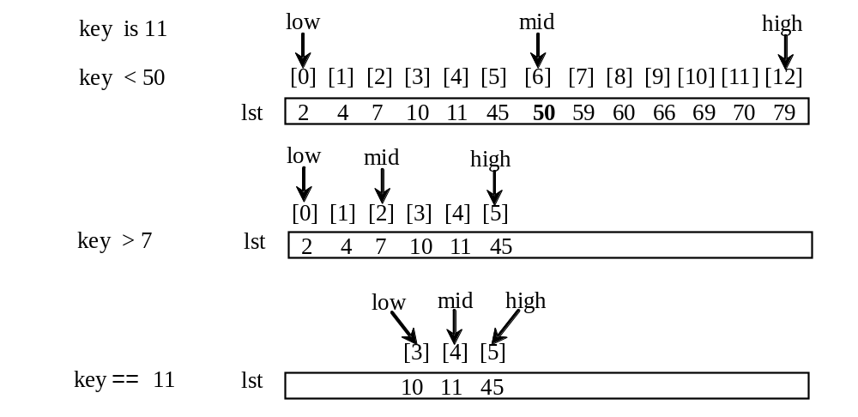
Binary Search, cont.

Slide 39
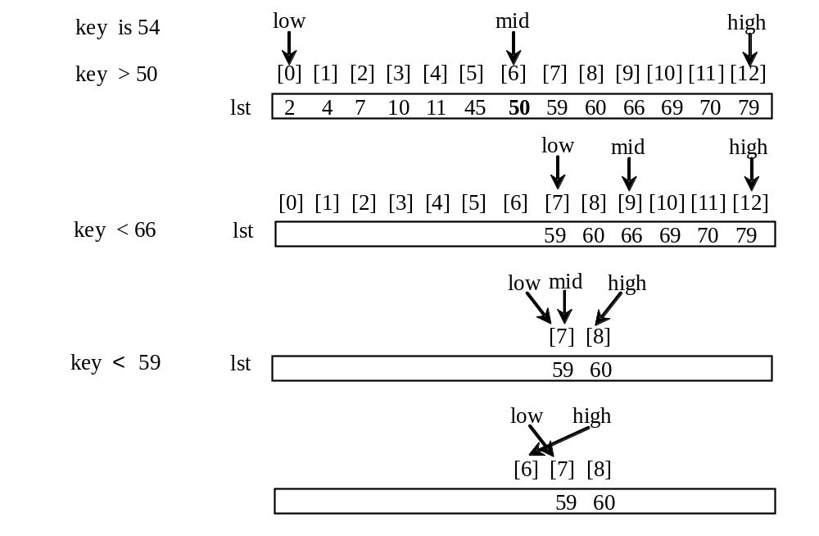
Binary Search, cont.

Slide 40
Binary Search, cont.
The binarySearch method returns the index of the element in the list that matches the search key if it is contained in the list. Otherwise, it returns
-insertion point - 1.
The insertion point is the point at which the key would be inserted into the list.

Slide 41
From Idea to Soluton
# Use binary search to find the key in the list
def binarySearch(lst, key):
low = 0
high = len(lst) - 1
while high >= low:
mid = (low + high) // 2
if key < lst[mid]:
high = mid - 1
elif key == lst[mid]:
return mid
else:
low = mid + 1
return –low - 1 # Now high < low, key not found

Slide 42
Sorting Lists
Sorting, like searching, is also a common task in computer programming. Many different algorithms have been developed for sorting. This section introduces two simple, intuitive sorting algorithms: selection sort and insertion sort.

Slide 43
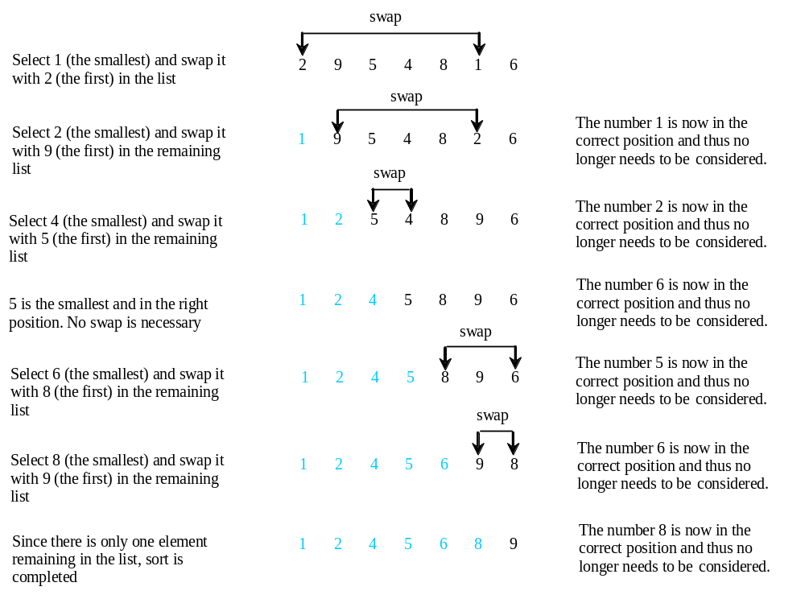
Selection Sort
Selection sort finds the largest number in the list and places it last. It then finds the largest number remaining and places it next to last, and so on until the list contains only a single number. Figure 6.17 shows how to sort the list {2, 9, 5, 4, 8, 1, 6} using selection sort.

Slide 44
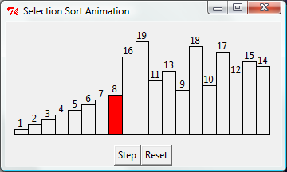
Selection Sort Animation
animation
http://www.cs.armstrong.edu/liang/animation/SelectionSortAnimation.html

Slide 45
From Idea to Solution
for i in range(0, len(lst)):
select the smallest element in lst[i.. len(lst)-1]
swap the smallest with lst[i], if necessary
# lst[i] is in its correct position.
# The next iteration apply on lst[i+1..len(lst)-1]
lst[0] lst[1] lst[2] lst[3] ... lst[10]
lst[0] lst[1] lst[2] lst[3] ... lst[10]
lst[0] lst[1] lst[2] lst[3] ... lst[10]
lst[0] lst[1] lst[2] lst[3] ... lst[10]
lst[0] lst[1] lst[2] lst[3] ... lst[10]
...
lst[0] lst[1] lst[2] lst[3] ... lst[10]

Slide 46
Expand
for i in range(0, len(lst)):
select the smallest element in lst[i.. len(lst)-1]
swap the smallest with lst[i], if necessary
# lst[i] is in its correct position.
# The next iteration apply on lst[i+1..len(lst)-1]
currentMin = lst[i]
currentMinIndex = i
for j in range(i + 1, len(lst)):
if currentMin > lst[j]:
currentMin = lst[j]
currentMinIndex = j

Slide 47
Expand
for i in range(0, len(lst)):
select the smallest element in lst[i.. len(lst)-1]
swap the smallest with lst[i], if necessary
# lst[i] is in its correct position.
# The next iteration apply on lst[i+1..len(lst)-1]
# Find the minimum in the lst[i..len(lst)-1]
currentMin = lst[i]
currentMinIndex = i
for j in range(i + 1, len(lst)):
if currentMin > lst[j]:
currentMin = lst[j]
currentMinIndex = j
# Swap lst[i] with lst[currentMinIndex] if necessary
if currentMinIndex != i:
lst[currentMinIndex] = lst[i]
lst[i] = currentMin

Slide 48
Wrap it in a Function
# The function for sorting the numbers
def selectionSort(lst):
for i in range(0, len(lst) - 1):
# Find the minimum in the lst[i..len(lst)-1]
currentMin = lst[i]
currentMinIndex = i
for j in range(i + 1, len(lst)):
if currentMin > lst[j]:
currentMin = lst[j]
currentMinIndex = j
# Swap lst[i] with lst[currentMinIndex] if necessary
if currentMinIndex != i:
lst[currentMinIndex] = lst[i]
lst[i] = currentMin
Invoke it
selectionSort(yourList)

Slide 49
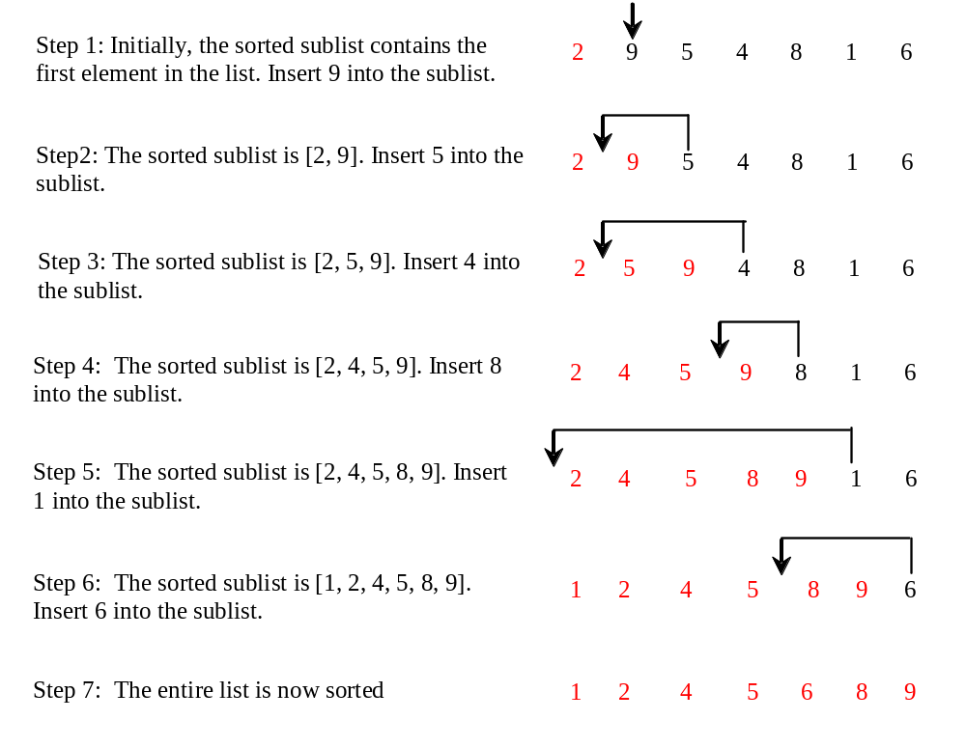
Insertion Sort
myList = [2, 9, 5, 4, 8, 1, 6] # Unsorted
The insertion sort algorithm sorts a list of values by repeatedly inserting an unsorted element into a sorted sublist until the whole list is sorted.

Slide 50
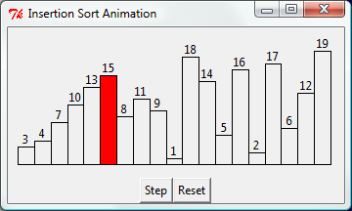
Insertion Sort Animation
animation
http://www.cs.armstrong.edu/liang/animation/InsertionSortAnimation.html

Slide 51
Insertion Sort
animation
myList = [2, 9, 5, 4, 8, 1, 6] # Unsorted
2 | 9 | 5 | 4 | 8 | 1 | 6
2 | 9 | 5 | 4 | 8 | 1 | 6
2 | 5 | 9 | 4 | 8 | 1 | 6
2 | 4 | 5 | 9 | 8 | 1 | 6
2 | 4 | 5 | 8 | 9 | 1 | 6
1 | 2 | 4 | 5 | 8 | 9 | 6
1 | 2 | 4 | 5 | 6 | 8 | 9

Slide 52
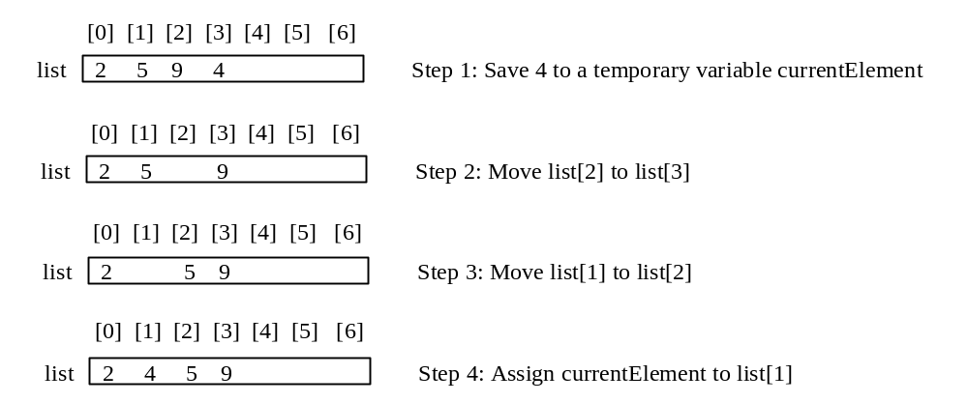
How to Insert?
The insertion sort algorithm sorts a list of values by repeatedly inserting an unsorted element into a sorted sublist until the whole list is sorted.

Slide 53
From Idea to Solution
for i in range(1, len(lst)):
insert lst[i] into a sorted sublist lst[0..i-1] so that
lst[0..i] is sorted.
lst[0]
lst[0] lst[1]
lst[0] lst[1] lst[2]
lst[0] lst[1] lst[2] lst[3]
lst[0] lst[1] lst[2] lst[3] ...

Slide 54
From Idea to Solution
for i in range(1, len(lst)):
insert lst[i] into a sorted sublist lst[0..i-1] so that
lst[0..i] is sorted.
Expand
k = i - 1
while k >= 0 and lst[k] > currentElement:
lst[k + 1] = lst[k]
k -= 1
# Insert the current element into lst[k + 1]
lst[k + 1] = currentElement
InsertSort

Slide 55
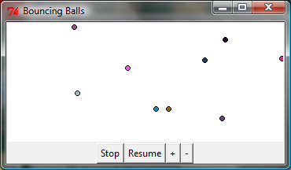
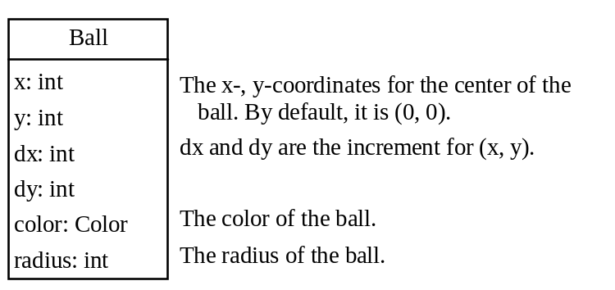
Case Studies: Bouncing Balls
BouncingBalls
Run

